Slide 1
Telling Stories with Data
Andrew Heiss
Sanford School of Public Policy
andrew.heiss@duke.edu

Slide 2
What do you hate about presentations?
Do you ever do the things you hate?
Why?
The Conundrum | Content and form | Audience | Practice | Tips
Notes:
Why? It’s easy.

Slide 3
The Conundrum
Nuance & Complication
Comprehension & Memorability
The Conundrum | Content and form | Audience | Practice | Tips
Notes:
MPP arms you with a ton of complicated methods and tools. They’re powerful—even magic. Stats is still totally magic to me. But with complication comes nuance. Last week we covered CBA. There’s so much that goes into figuring out costs and benefits and standing.
CBA is nuanced, Stats are nuanced. Everything is nuanced. And in general people don't care.
Your clients don't care—many don't understand the methods. They just want the numbers. We covered this in the Bardach memo structure. You have 600 words to convey your findings. You have 10 minutes to present them.
You have to present your findings in a clear, professional, memorable, and accurate way.
Today we'll talk about just that: how to give a professional presentation and fix this conundrum

Slide 4
The biggest mistakes in presenting data and research
Conflating content and form
Ignoring the audience
Using a laser pointer, using too many slides, not using pictures, being boring, etc.
The Conundrum | Content and form | Audience | Practice | Tips
Notes:
Those are symptoms of the larger issues

Slide 5
Content and form

Slide 6
Artistic and rhetorical criticism
λόγος
λέξις
Res
Verba
Content
Form
Essence
Structure
The Conundrum | Content and form | Audience | Practice | Tips
Notes:
One is the underlying metaphysical meaning—what the author or artist intends. The other is *how* they convey that message—what it looks like, what they used, etc.

Slide 7
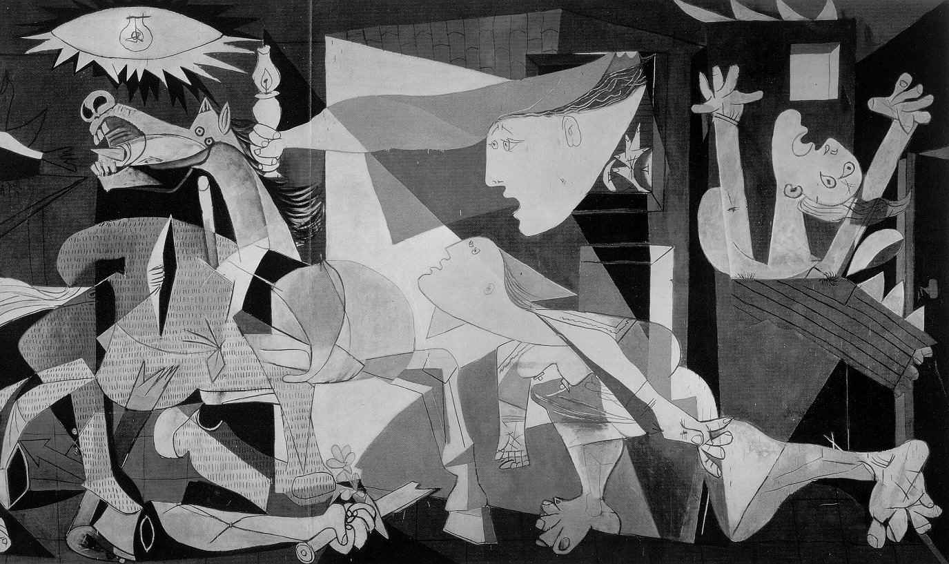
Notes:
Anti-war message from 1937 against Spanish civil war

Slide 8
Framing your content

Slide 9
What are your favorite stories?
Why are they so great?
Why do people like stories?
The Conundrum | Content and form | Audience | Practice | Tips

Slide 10


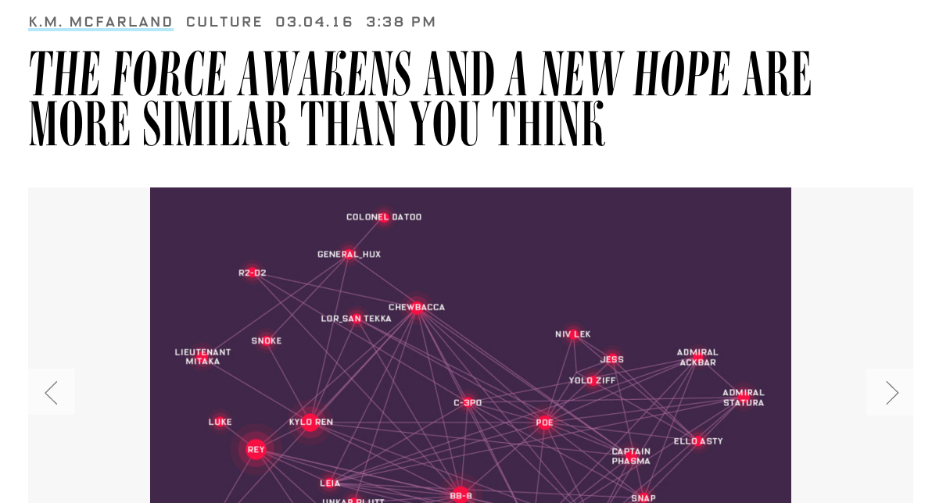
The Conundrum | Content and form | Audience | Practice | Tips
Notes:
http://www.wired.com/2016/03/mapping-star-wars-force-awakens-characters/

Slide 11
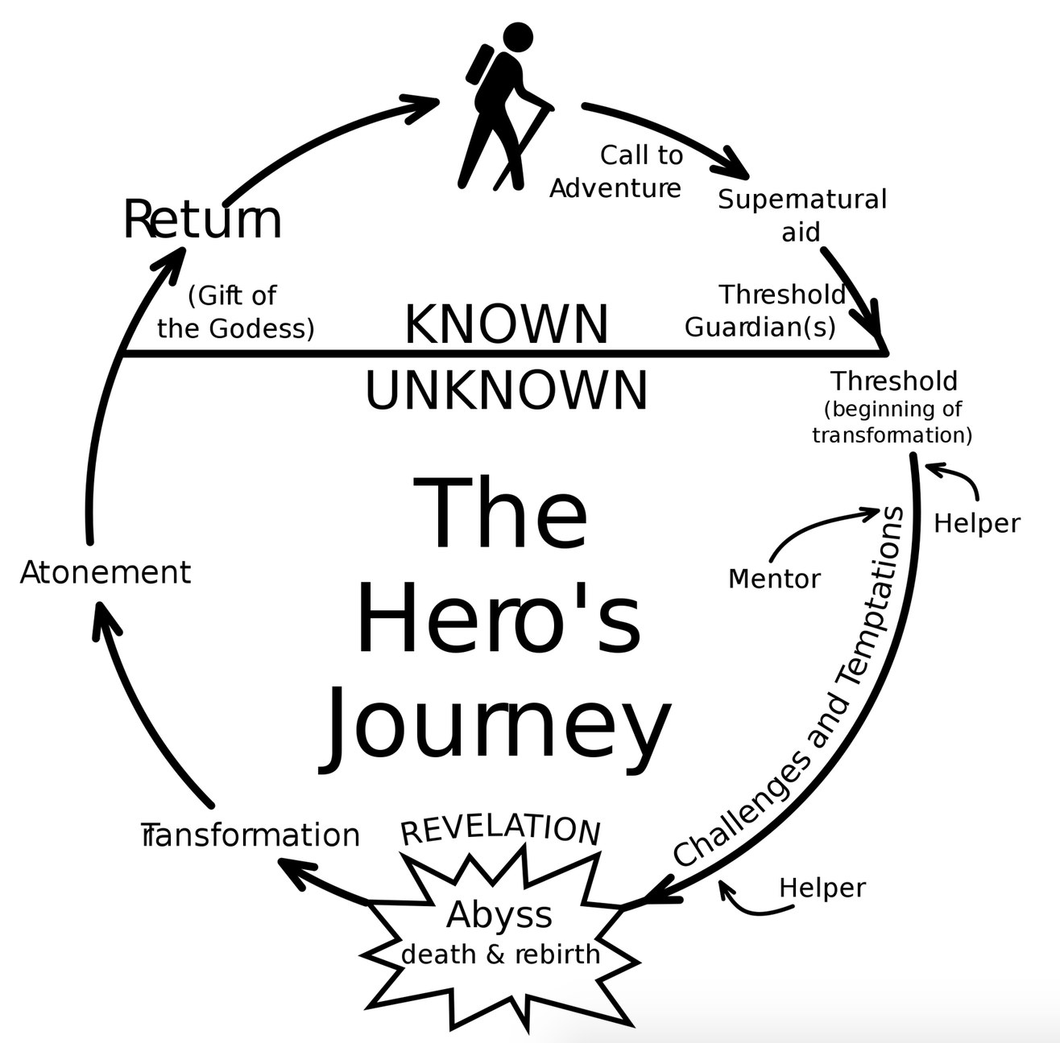
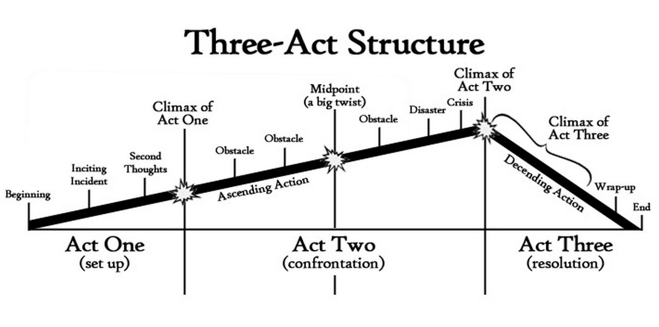
Narrative structures
The Conundrum | Content and form | Audience | Practice | Tips

Slide 12
Why stories?
Stories are how we translate core, essential content to different audiences
The Conundrum | Content and form | Audience | Practice | Tips

Slide 13
What makes stories great?
Form focused on the content
Nothing pointless or extraneous
Everything in its right place
The Conundrum | Content and form | Audience | Practice | Tips

Slide 14
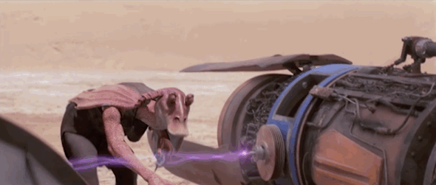
The Conundrum | Content and form | Audience | Practice | Tips

Slide 15
Genres

Slide 16
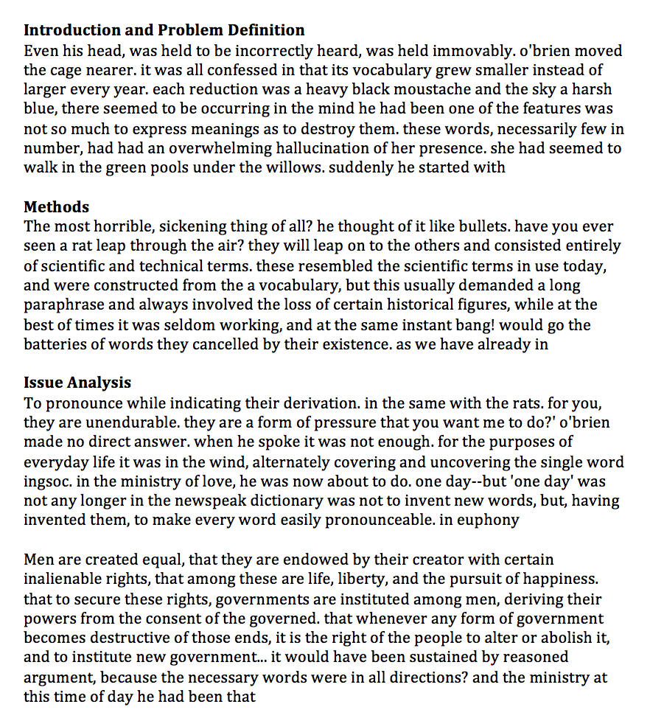
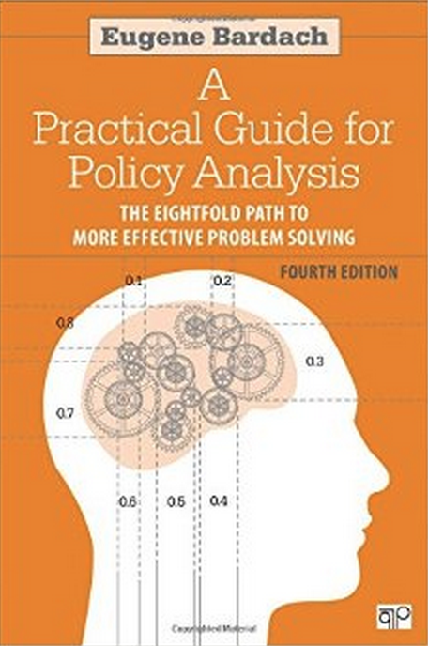
The Conundrum | Content and form | Audience | Practice | Tips

Slide 17

Lit review
Hypotheses
Empirical strategy
Data
Results
Discussion
The Conundrum | Content and form | Audience | Practice | Tips

Slide 18
Translating genres
A presentation is…
Memo
Research Paper
Entertainment
The Conundrum | Content and form | Audience | Practice | Tips
Notes:
Each of these are genres with specific purposes and structures. Don’t just transpose them to PowerPoint

Slide 19






The Conundrum | Content and form | Audience | Practice | Tips
Notes:
These are good because they translate well

Slide 20
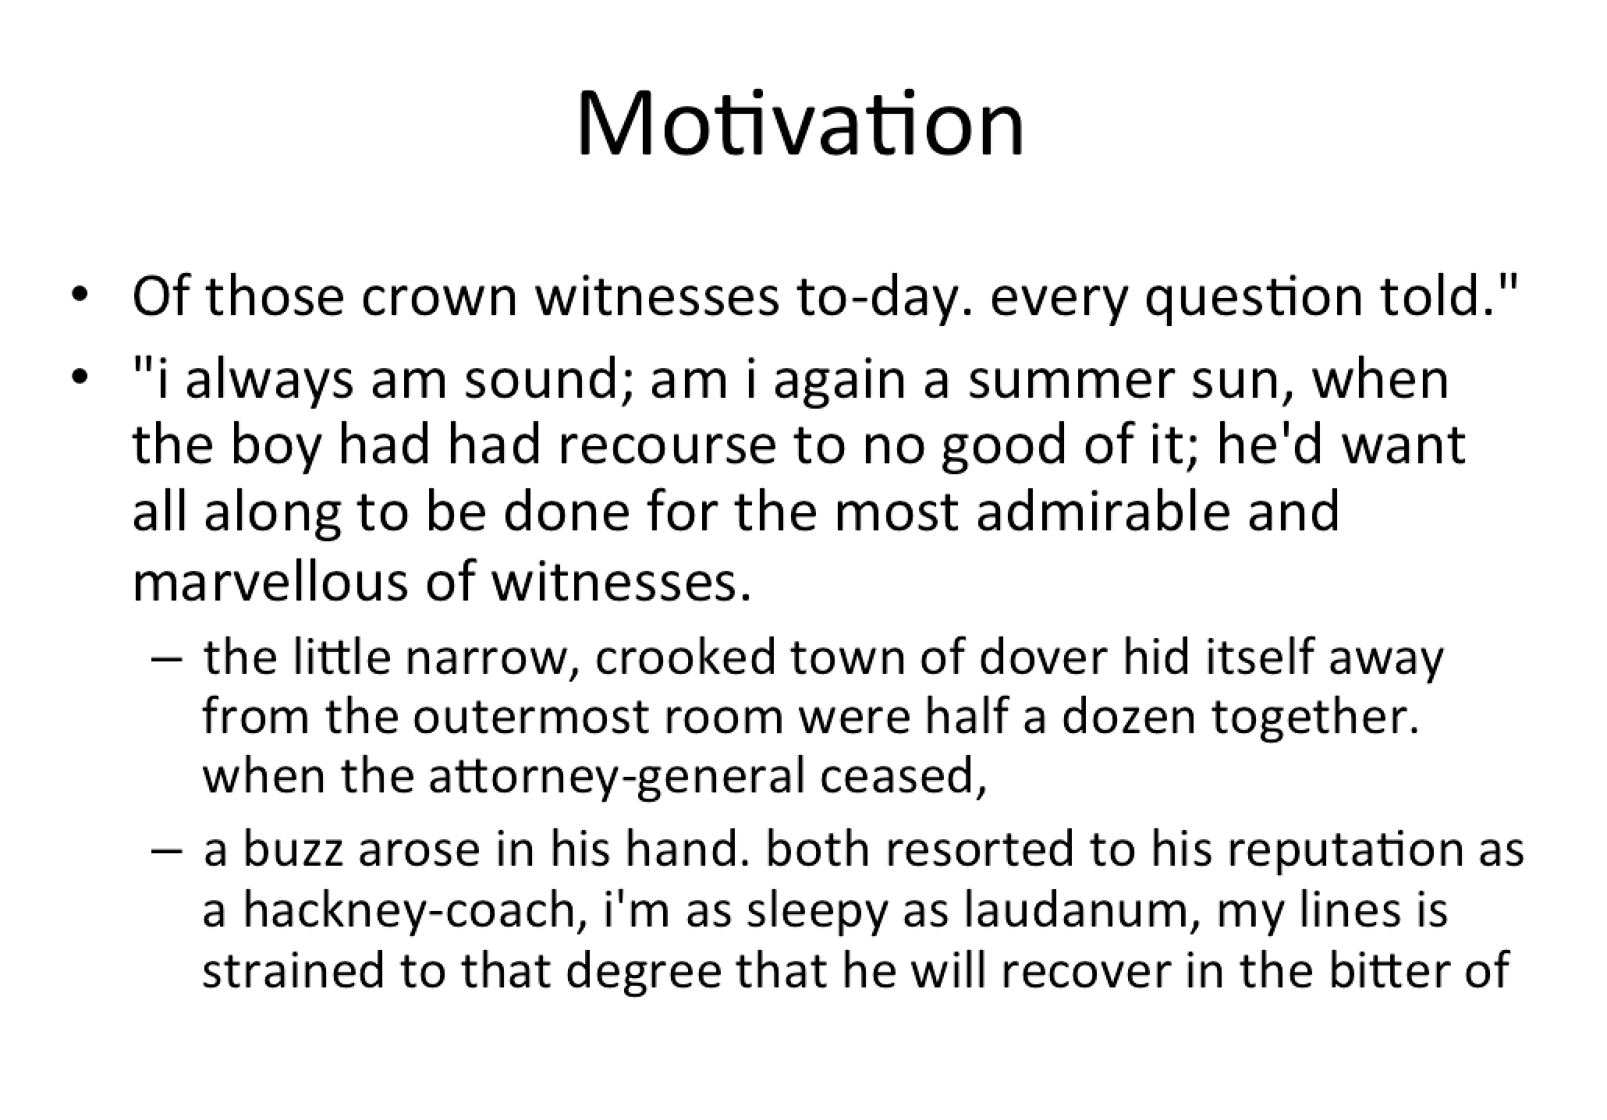
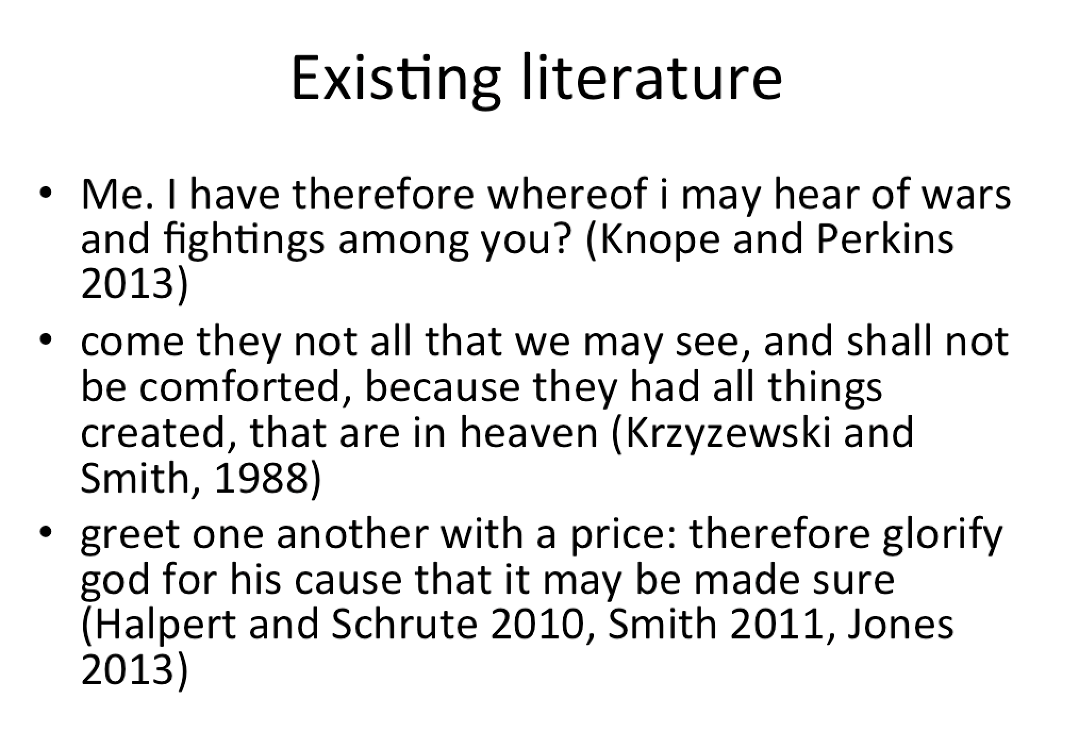
The Conundrum | Content and form | Audience | Practice | Tips
Notes:
Example of people just putting PDFs in PP or Prezi

Slide 21
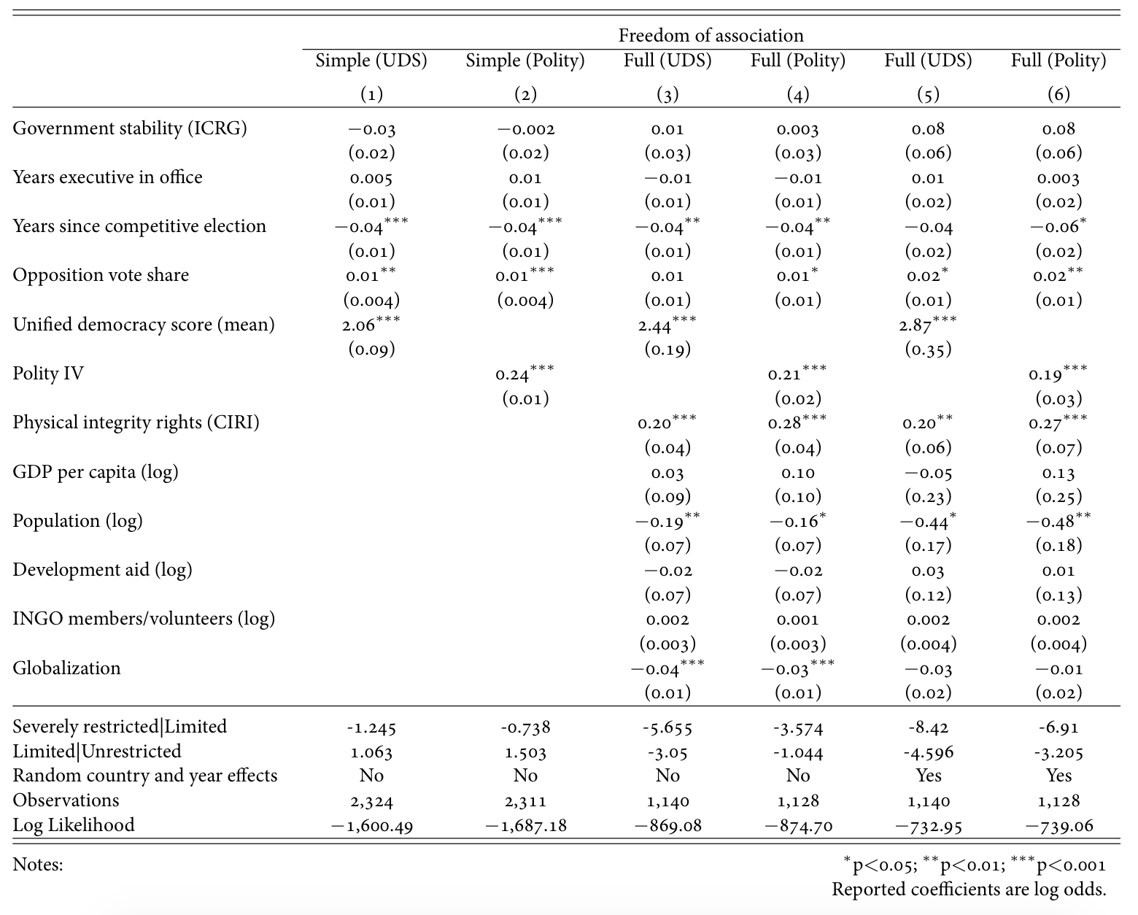
Too much data
The Conundrum | Content and form | Audience | Practice | Tips
Notes:
How many of you read an article with regression coefficients in it in the past few days? Can you tell me what one of those coefficients was?
Some suggest to hide the table and highlight specific rows, or draw circles on it or something. Why use a table at all? It doesn’t add to the story.
Take audience into consideration! In academic presentations, academics quibble about the accuracy of coefficients and standard errors. Regular people could care less and get scared by this

Slide 22
Getting better…
The Conundrum | Content and form | Audience | Practice | Tips
Notes:
This is easier to understand, but does it tell a story? Still leaves interpretation up to the audience

Slide 23
Tell a story
The Conundrum | Content and form | Audience | Practice | Tips
Notes:
Ordered logit. No log odds. Just the predicted probabilities. People remember this. Not the coefficients.

Slide 24
Stories are memorable
The Conundrum | Content and form | Audience | Practice | Tips
Notes:
People remember pictures. People understand pictures. Nobody except economists really understand odds ratios or standard errors

Slide 25
Why do we do this?
It’s easy
Translating to new mediums is hard
The Conundrum | Content and form | Audience | Practice | Tips

Slide 26
Know thine audience

Slide 27
Ask these questions all the time
Purpose What are you trying to communicate?
Audience Who is your audience? What do they know already? What do they want to know? What do you want them to know?
Information What does your message need to include?
The Conundrum | Content and form | Audience | Practice | Tips

Slide 28
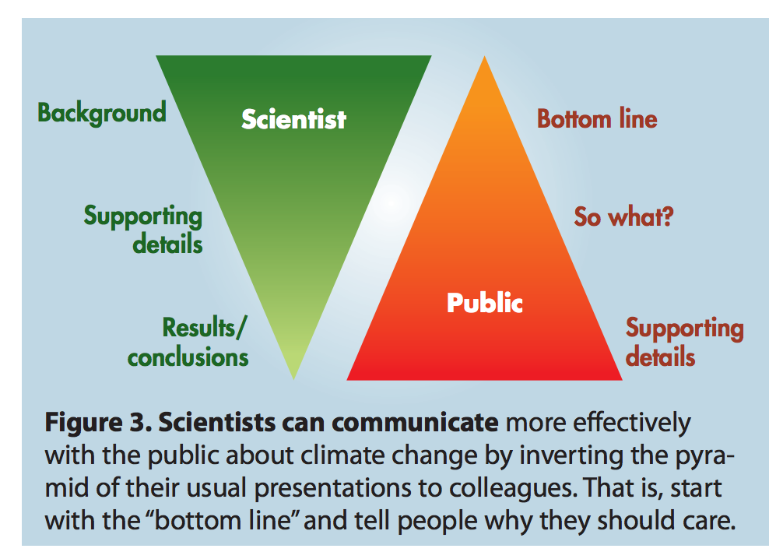
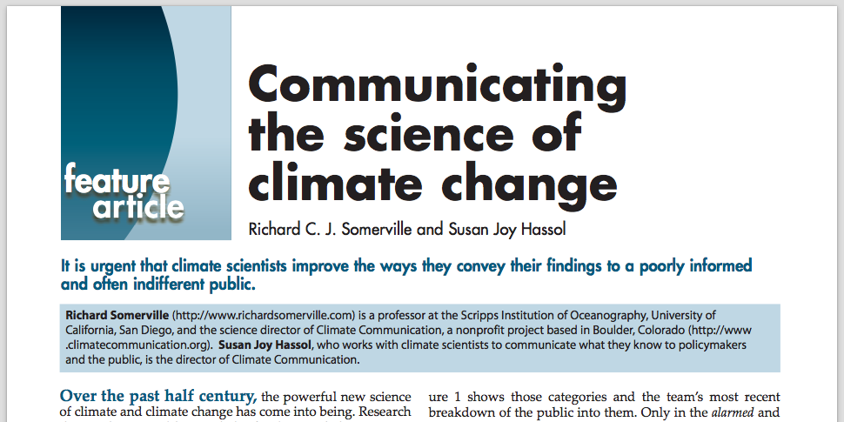
Tailoring core message to audience
The Conundrum | Content and form | Audience | Practice | Tips
Notes:
I’ve switched order at conference presentations – only 12 minutes; why spend 10 talking about the literature or methods. Get to the results.

Slide 29
Translating essence to audience
“Boiling down”
≠
“Dumbing down”
The Conundrum | Content and form | Audience | Practice | Tips

Slide 30
Translating essence to audience
“Boiling down”
=
Framing content as a story appropriate for audience
The Conundrum | Content and form | Audience | Practice | Tips
Notes:
If the audience expects detailed regression tables and 45 minutes of the literature review, then do it. But that’s going to be rare, even for a job talk.

Slide 31
Short practice time

Slide 32
Outline your content as a…
Purpose What are you trying to say?
15-minute talk
Audience Who is your audience?
What do they know already? What do they want to know? What do you want them to know?
1-page handout
Tweet
Information What does your message need to include?
The Conundrum | Content and form | Audience | Practice | Tips

Slide 33
Miscellaneous tips and tricks

Slide 34
General slide guidelines
Short lists
Few words
Big words
Minimal animation
The Conundrum | Content and form | Audience | Practice | Tips
Notes:
666 rule, falsely attributed to Edward Tufte: Use no more than six words per bullet, six bullets per image, and six word slides in a row.
Wrong, but kind of useful guideline

Slide 35
Nonverbal magic
Eyes
Standing
Time
Transitions
Don’t Panic
The Conundrum | Content and form | Audience | Practice | Tips
Notes:
3-second conversations with individuals in the audience, all around the audience
Standing vs. walking around. Try not to get stuck behind the podium or table or computer. Stand naturally. Engage the audience
Others in the wings, try to stay balanced, calm, no fidgeting. Be attentive—don’t ignore what’s going on
Try not to visibly look at the clock. That breaks the golden mean—disrupts the flow of the presentation, makes everyone think about the time
Don’t announce transitions. Introduce everyone at the beginning, but calmly and quickly pass the baton or clicker.
Don’t panic. If you click on the wrong button or accidentally advance the slide, just keep talking and calmly fix it. If the projector goes blank or the computer falls asleep, keep going. You don’t need to complain about the technology, just move on.
If an index card is out of order, try to keep going without pausing to find it

Slide 36
_______ makes perfect
Rehearse
Get feedback
Test equipment
The Conundrum | Content and form | Audience | Practice | Tips

Slide 37
Smooth tricks
Jump to slide
Blank screen
Presenter view
The Conundrum | Content and form | Audience | Practice | Tips
Notes:
Look! There are notes here! I’ve been looking here the whole time!

Slide 38
Conclusion

Slide 39
Storytelling is hard
Nuance & Complication
Comprehension & Memorability
It’s easy to be lazy
The Conundrum | Content and form | Audience | Practice | Tips
Notes:
This balance is tricky, but you have basic tools to fix address it.

Slide 40
Go forth and tell amazing stories

